Slide 1
CAR RESALE VALUE PREDICTION

Slide 2
OBJECTIVES
The system used to anticipate the value of used cars is called to make accurate predictions about used automobile values
It facilitates flawless remote car sales for users without the need for human interaction, value to remove biased assessment.
In order to anticipate the car's resale value, the system only considers a small number of parameters due to the scarcity of data.
This system is online, thus the existing one does not When estimating the resale value, consider any physical damage to the car's body or engine.

Slide 3
EXISTING SYSTEM
The manufacturer determines the prices of new cars on the market after deducting some additional expenses imposed by the government in the form of taxes.
Customers may be confident that their investment will be profitable when they buy a new car.
However, due to the rising price of new cars and consumers' inability to buy new cars because of a lack of funds, used car sales are increasing globally.
A system for forecasting used car prices is necessary in order to accurately evaluate the value of the vehicle using a variety of features.

Slide 4
DISADVANTAGES
Not accurate
Not efficient

Slide 5
PROPOSED SYSTEM
Because the price of a used automobile depends on the vehicle's attributes, precise and accurate price prediction of used cars needs specialist domain knowledge.
Consequently, this paper proposed a machine learning-based using random forest algorithm to predict the value of the resale car software system where the price is dependent on factors like model of car, manufacturing year, Brand, city, version, safety, colour, if dealer/individual, mileage, fuel type (CNG, Petrol, Diesel), alloy rims, the braking system, the air conditioning, its physical state, the number of previous owners, interior, and power steering These elements are used to forecast used automobile prices. Choosing whether a used car's listed internet pricing is reasonable or not might be challenging.

Slide 6
ADVANTAGES
Time consuming
Well-known of the product
Efficient and accuracy

Slide 7
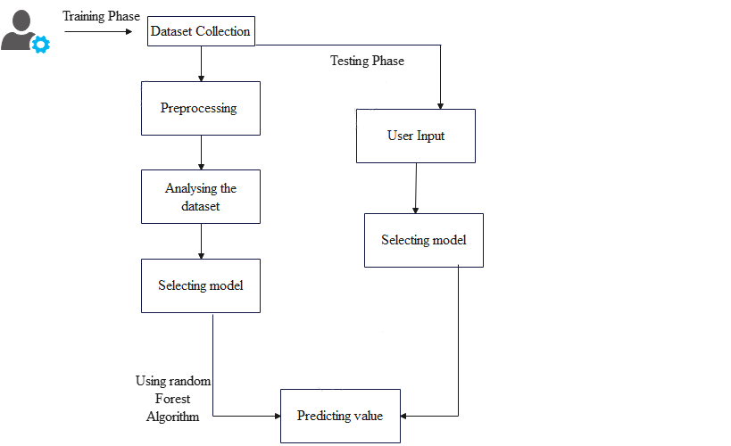
SYSTEM ARCHITECTURE

Slide 8
HARDWARE REQUIREMENTS
Processor : Dual core processor 2.6.0 GHZ
RAM : 4 GB
Hard disk : 320 GB
Compact Disk : 650 Mb
Keyboard : Standard keyboard
Monitor : 15 inch color monitor

Slide 9
SOFTWARE REQUIREMENTS
Operating system : Windows OS
Front End : Python
Back End : MySQL SERVER
IDLE : Python 2.7 IDLE

Slide 10
MODULES
Dataset
Preprocessing
Analysing the dataset
Selecting model
Predicting value

Slide 11
DATASET
In this paper, we put forth a research proposal based on a dataset for used cars, specifically. The Kaggle website's Cardekho Used Car Sales Vehicle Dataset.
Car Name: The cars with this name are considered used car models.
Year: The used car's year of production
Selling Price: The cost at which the current owner purchases a used car, based on the vehicle's specifications and state.
Present Price: The price stated by the seller Kms Driven: The total distance the owner has driven the pre-owned vehicle
Fuel Type: The type of fuel your car uses, such as CNG, gasoline, diesel, or CNG+petrol.
Transmission: There are two driving modes: manual and automatic

Slide 12
PREPROCESSING
It is a crucial step in the process where we modify the raw data to make it suitable for studies on machine learning models.
We must utilise charts to plot data, such as the data's histogram, in order to comprehend the dataset.
It is established that the dataset contained many outliers due to the enormous number of results for used autos.
The most recent model years of automobiles and those with low mileage (in kilometres travelled) sell at a premium.
Other variables like accident history and condition, though, did not support this premium sell.

Slide 13
ANALYSE AND SELECTING THE MODEL
In this module , admin can train the dataset like car name, year selling price ,Km-driven, transmission etc. user can give the inputs in the user defined paramaters
In this selecting module user can select the car models from the trained dataset in the default value

Slide 14
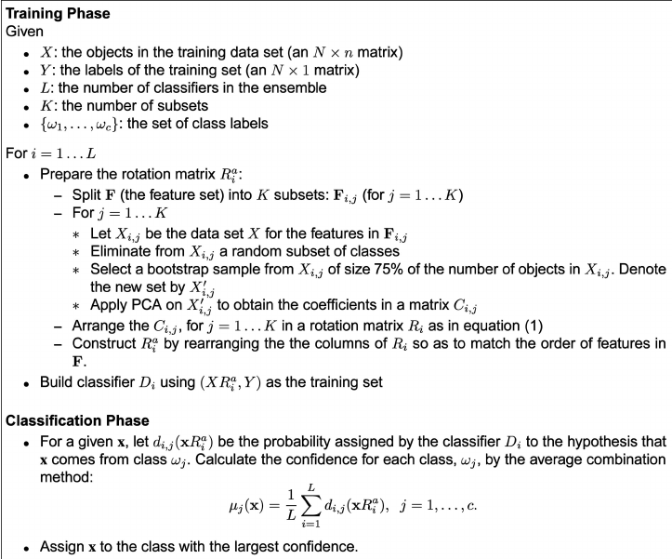
PREDECTING THE VALUE
Using the machine learning algorithm, predicting the car resale’s value in the user defined dataset

Slide 15
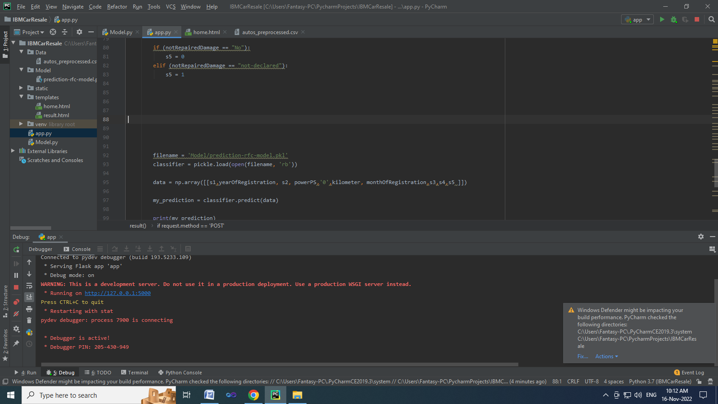
Screenshots

Slide 16
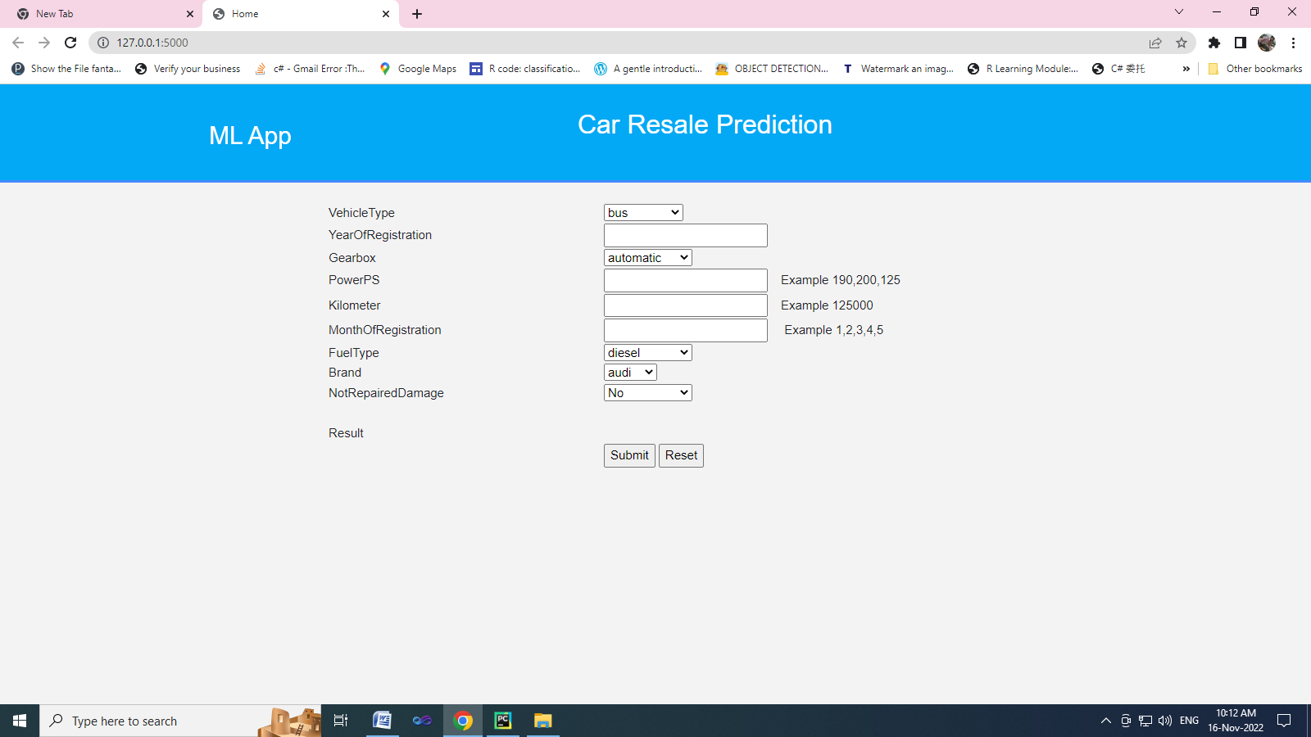

Slide 17
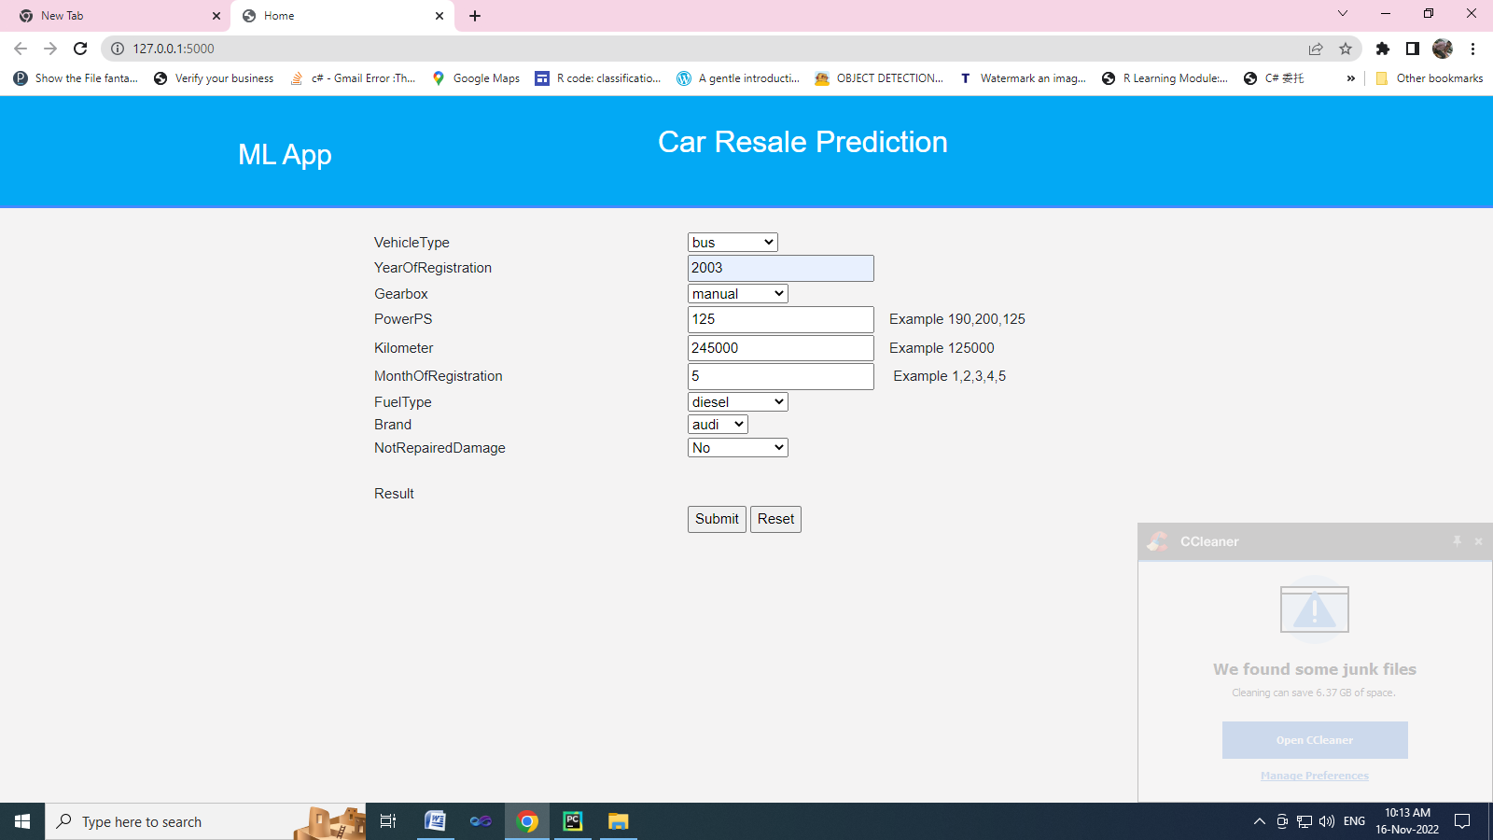

Slide 18


Slide 19
CONCLUSION
Employing the Random Forest Algorithm with a 97 accuracy level in this project.
The lack of records for vintage cars is a weakness of this study. We can retrain our models in the future if we have more data, which could lead to a model that is more accurate and stable.
In order to forecast used automobile prices, this study used a variety of models.
More data can lead to predictions that are more reliable. Second, there might be additional traits that are reliable predictors.
For instance, the following elements could enhance the model: the quantity of doors, the color, the length of time required for mechanical and cosmetic reconditioning, the used-to-new ratio, and the appraisal-to-trade ratio.

Slide 20
FUTURE ENHANCEMENT
Once sufficient data has been gathered, efficient deep learning techniques like LSTM (Long Short-Term Memory) or RNN (Recurrent Neural Networks) can be used. This can significantly increase accuracy while lowering RMSE.
Only a few features are currently used to forecast a car's resale value. Additional features could be added to this.
CNN can also be used to assess a car's physical condition from images, such as spotting dents and scratches, and to forecast a more accurate resale value.

Slide 21
REFERENCES
[1] Dhwani Nimbark ,“ Car Resale Value Prediction System”,2021.
[2] Prashant Gajera ,“ Old Car Price Prediction with Machine Learning”,2021.
[3] Anu Yadav “ Object Detection And Used Car Price Predicting Analysis System (ucpas) Using Machine Learning Technique”,2021.
[4] Fadi Al-Turjman “ Vehicle Price Classification and Prediction Using Machine Learning in the IoT Smart Manufacturing Era”
[5] B.Lavanya “ Vehicle Resale Price Prediction Using Machine Learning”,2021.

Slide 22
THANK YOU

